Slide 1




DEPARTMENT OF COMPUTER SCIENCE AND ENGINEERING
JORHAT ENGINEERING COLLEGE
PARKLINK
SMART PARKING SOLUTION
JINTU NATH (210710007019)
MRINMOY SHYAM (210710007028)
NILAKHYA MANDITA BORDOLOI (210710007029)
PARAG CHOUDHURY (210710007032)

Slide 2
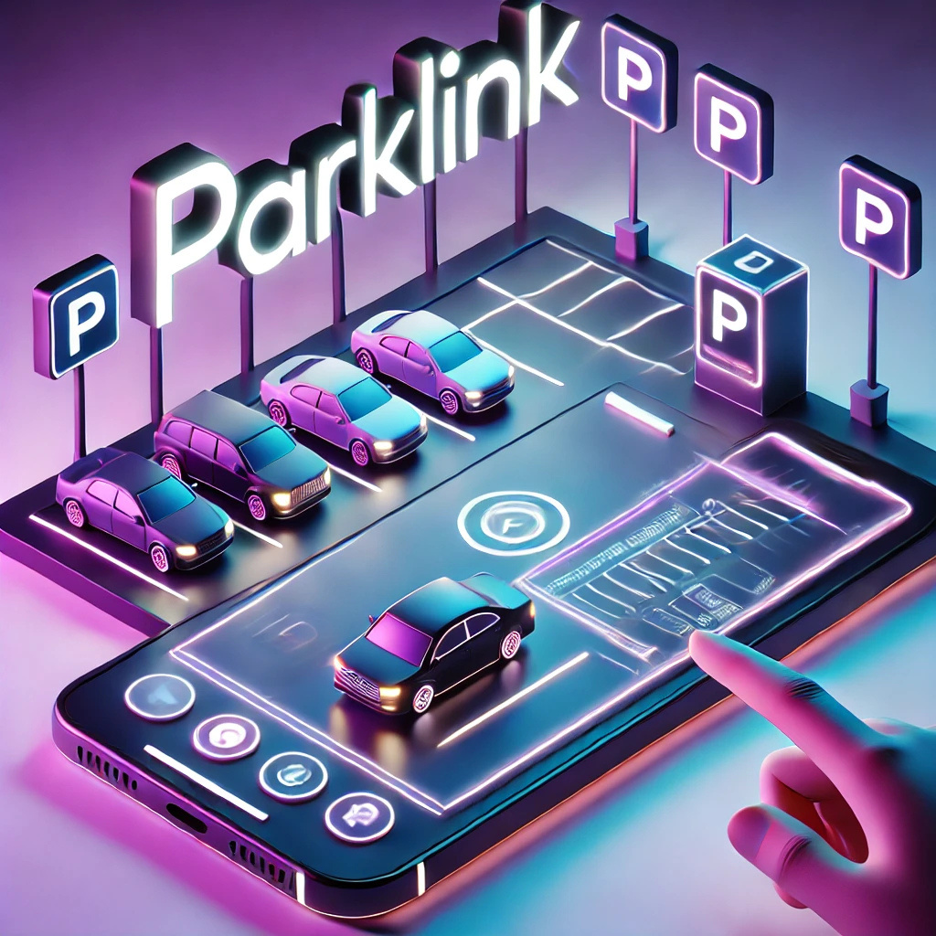

DEPARTMENT OF COMPUTER SCIENCE AND ENGINEERING
JORHAT ENGINEERING COLLEGE
PROBLEM STATEMENT
The growing urbanization in Indian cities has increased the demand for efficient parking solutions. Drivers often waste time searching for available parking spots, causing congestion and stress.
Our goal is to develop a Smart Parking Solution using IoT technology to streamline parking availability information, reducing search times and improving traffic conditions. The system detects parking slot occupancy using sensors and communicates the data to a web-based dashboard in real-time.

Slide 3

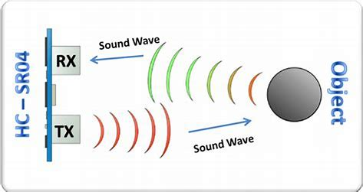
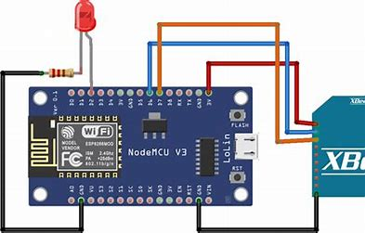
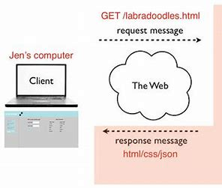
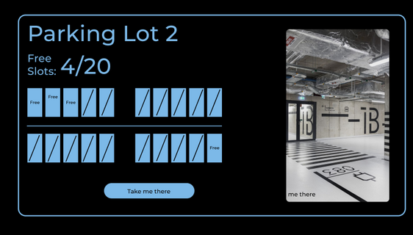
DEPARTMENT OF COMPUTER SCIENCE AND ENGINEERING
JORHAT ENGINEERING COLLEGE
APPROACH
Ultrasonic sensors for slot detection
ESP32 for processing and server communication
Web server backend
Dashboard visualization

Slide 4
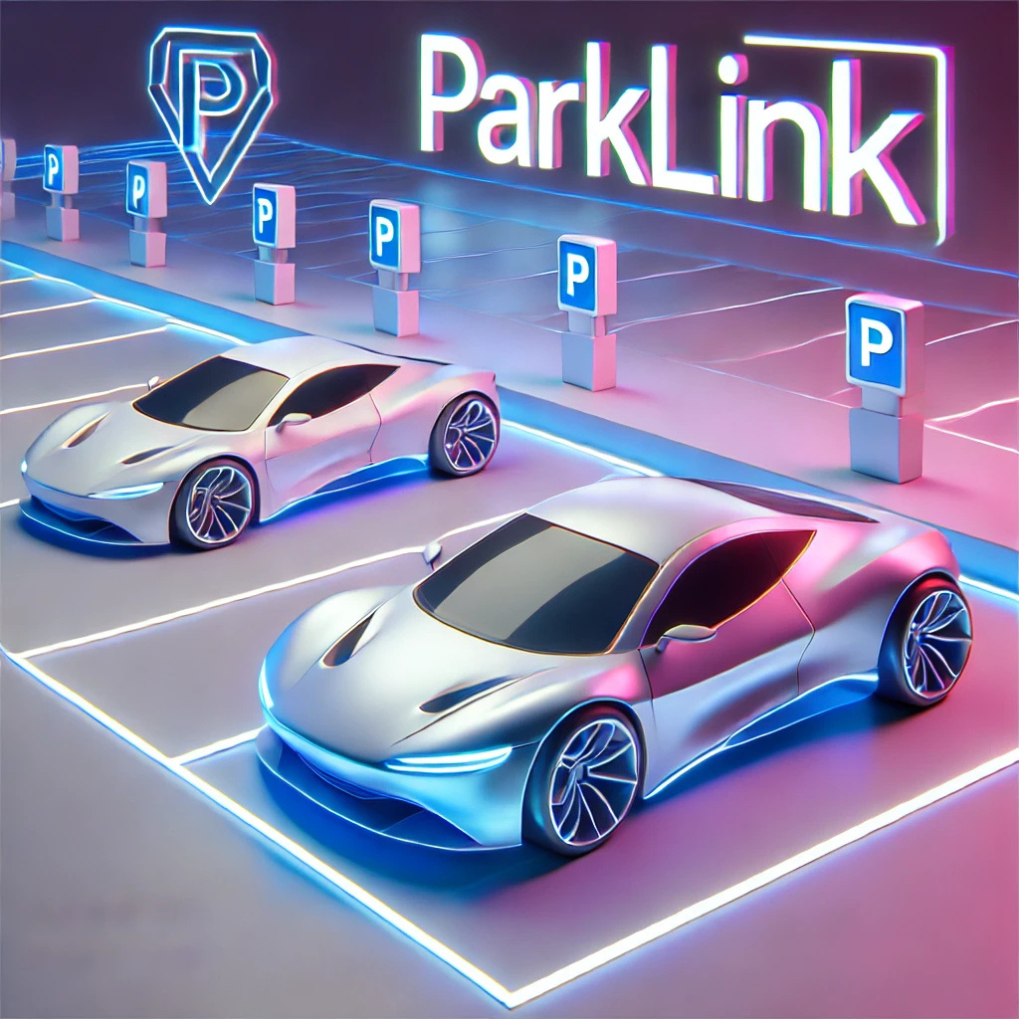


DEPARTMENT OF COMPUTER SCIENCE AND ENGINEERING
JORHAT ENGINEERING COLLEGE
WORKING MECHANISM
1.
3.
Users can search for nearby parking spots using the ”Search for Parking” button. This sends a request to the server for information on available spots.
The server receives real-time data from ultrasonic sensors connected to ESP32 mi controllers at each parking spot. Sensors detect whether a slot is occupied based on the proximity of a vehicle.
Alternatively, users can browse through a list of parking spaces manually.
2.
4.
Detected data is processed and transmitted to the server, which updates the parking slot status as available or occupied.
5.
Additional features include pre-booking, favorite spots, wallet management, and vehicle dashboards for tracking parking history and expenses.
The frontend dashboard, built with ReactJS, displays this information and allows users to navigate to their chosen parking spot using Google Maps integration.
6.

Slide 5
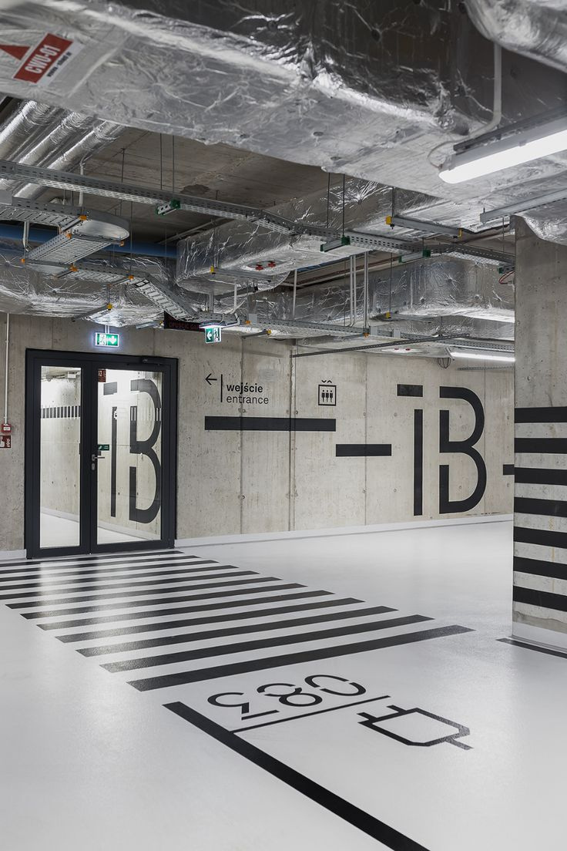
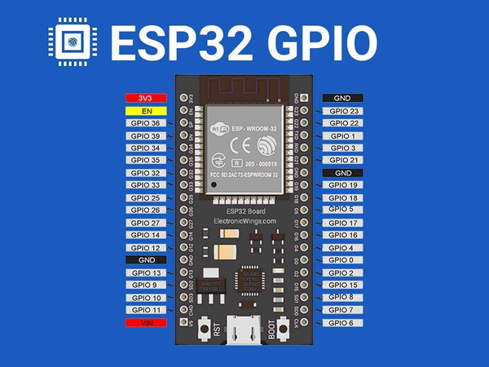
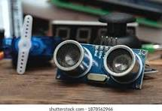

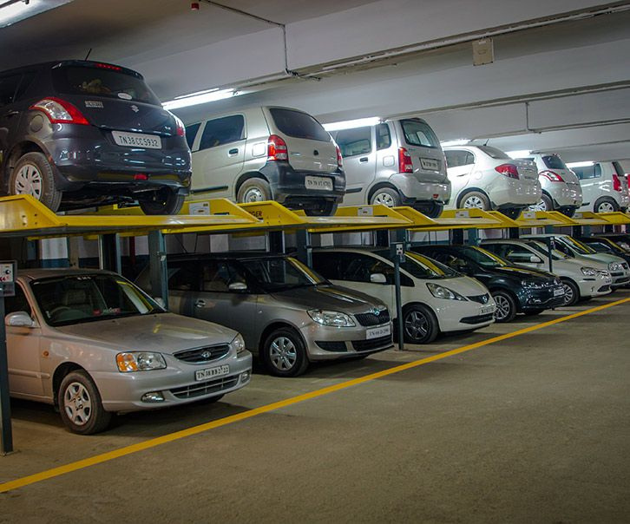



DEPARTMENT OF COMPUTER SCIENCE AND ENGINEERING
JORHAT ENGINEERING COLLEGE
TECH STACK
ESP 32
ULTRASONIC SENSOR
MY SQL
NODE JS
HTML, CSS, JAVASCRIPT
FIGMA

Slide 6
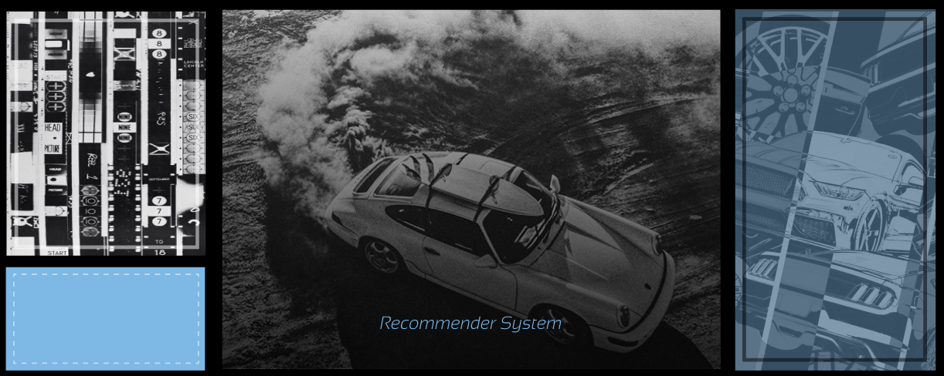
DEPARTMENT OF COMPUTER SCIENCE AND ENGINEERING
JORHAT ENGINEERING COLLEGE
TECHNICAL FEATURES
The system architecture supports the addition of multiple parking lots across diverse locations, with real-time synchronization of data.
Modular design allows easy integration of future features like auto matic billing, advanced analytics, and mobile application support.
ESP32 and ultrasonic sensors are designed to operate reliably in var ious environmental conditions.
SCALABILITY
FLEXIBILITY
DURABILITY
Ensures accurate and synchronized data transmission between hard ware components and the server.
MySQL database adheres to atomicity, consistency, isolation, and durability, ensuring reliable data transactions.
ACID PROPERTIES
CONSISTENCY

Slide 7
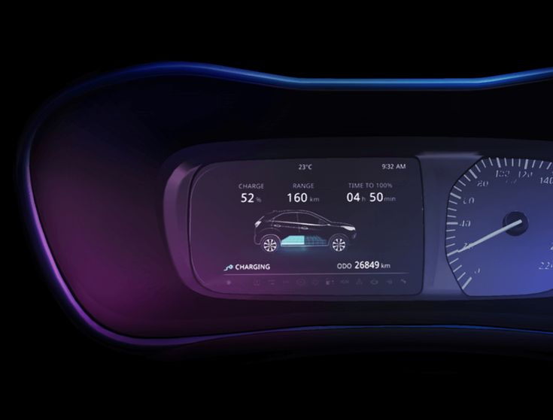
DEPARTMENT OF COMPUTER SCIENCE AND ENGINEERING
JORHAT ENGINEERING COLLEGE
UNIQUE PERSPECTIVES
The intuitive interface, combined with Google Maps navigation and pre-booking options, offers a seamless parking experience.
Tailored dashboards for users, providers, and ad ministrators ensure efficient management and monitoring.
Simplifies transactions and reduces reliance on external payment systems.
ENHANCED USER EXPERIENCE
COMPREHENSIVE DASHBOARDS
INTEGRATED WALLET SYSTEM
Differentiates the solution by offering free helpline and maintenance services to parking providers.
Adaptable to both urban and rural settings, making it suitable for diverse market needs.
PROVIDER HELPLINE AND MAINTENANCE
CUSTOMIZABILITY

Slide 8
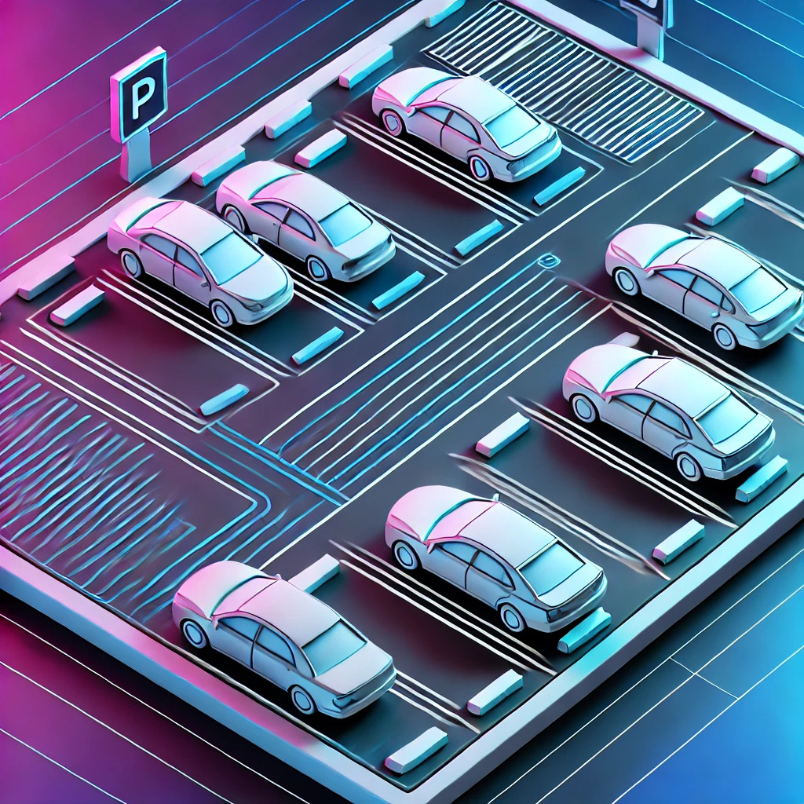
DEPARTMENT OF COMPUTER SCIENCE AND ENGINEERING
JORHAT ENGINEERING COLLEGE
ADVANTAGES
• Reduces time spent searching for parking, thereby alleviating traffic congestion.
• Offers real-time monitoring of parking slots for improved efficiency.
• Scalable for implementation in large parking lots or structures.
• Enhances user convenience with features like pre-booking and navigation.
• Enables data-driven decision-making for service providers.

Slide 9
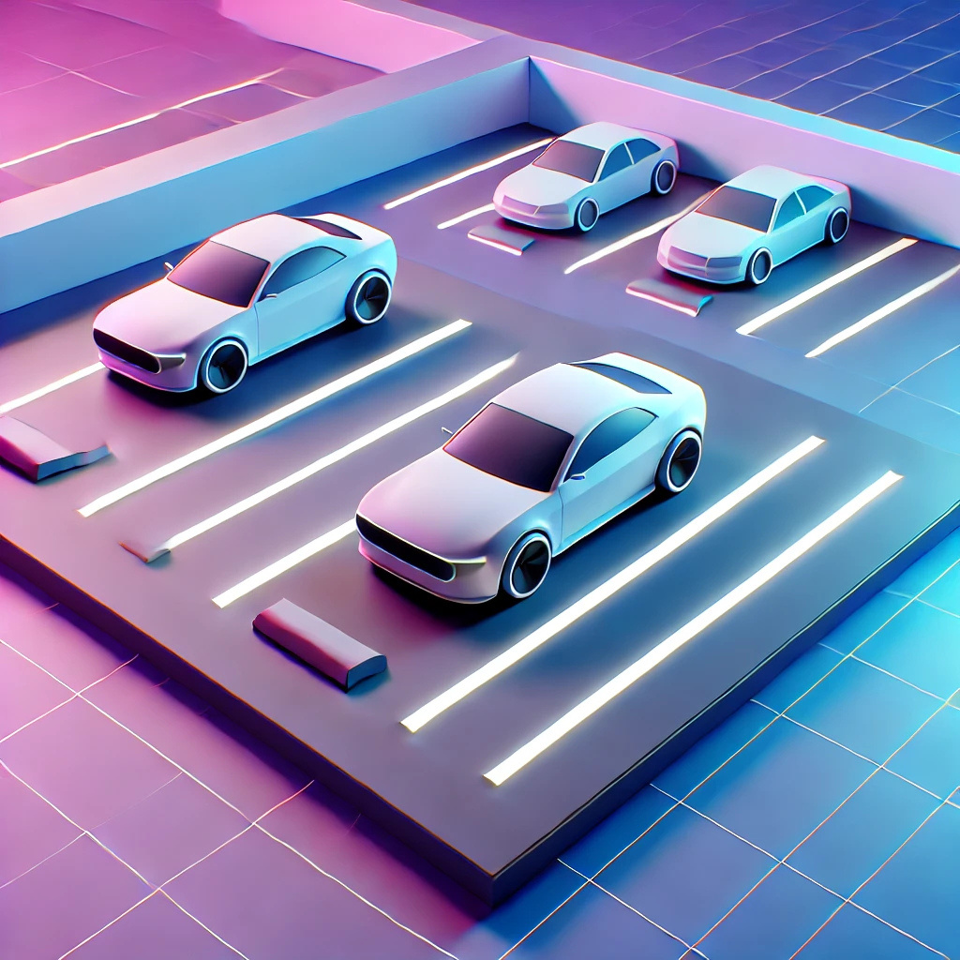

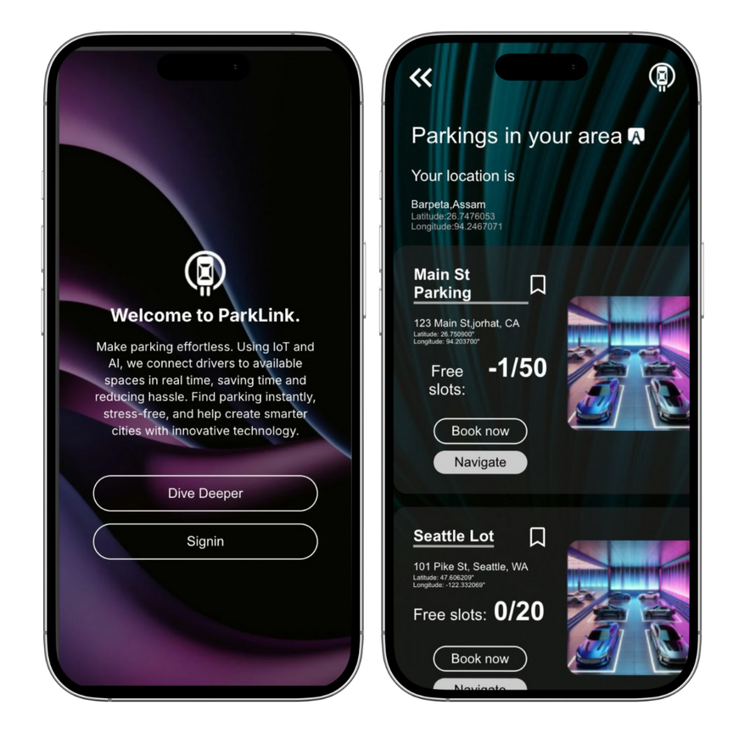

DEPARTMENT OF COMPUTER SCIENCE AND ENGINEERING
JORHAT ENGINEERING COLLEGE
PARKL NK
Efficient Parking, Smarter Cities.
DEMONSTRATION

Slide 10
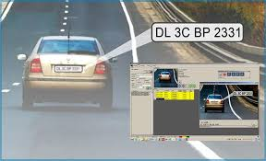
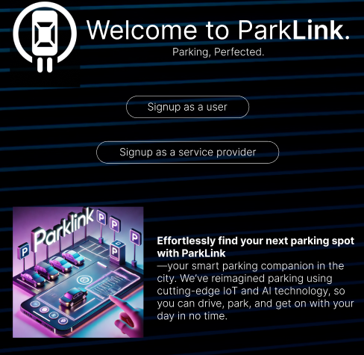

DEPARTMENT OF COMPUTER SCIENCE AND ENGINEERING
JORHAT ENGINEERING COLLEGE
FUTURE SCOPE
Number Plate Recognition
Workforce Management
Mobile App Development

Slide 11

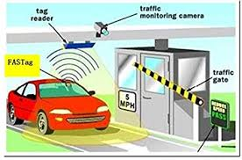
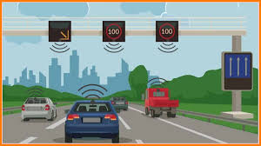
DEPARTMENT OF COMPUTER SCIENCE AND ENGINEERING
JORHAT ENGINEERING COLLEGE
FUTURE SCOPE
What3Words Integration
Fast Tag Integration
GPS-based Billings

Slide 12
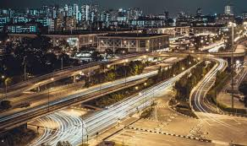



DEPARTMENT OF COMPUTER SCIENCE AND ENGINEERING
JORHAT ENGINEERING COLLEGE
CHALLENGES IN INDIAN CONTEXT
Infrastructure
Cost Sensitivity
Internet Connectivity
Legal and Privacy Concerns

Slide 13
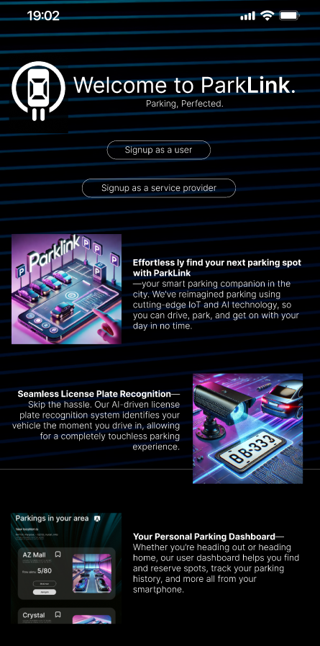

DEPARTMENT OF COMPUTER SCIENCE AND ENGINEERING
JORHAT ENGINEERING COLLEGE
CONCLUSION
Parklink addresses parking challenges in India by offering real-time availability information and an efficient, scalable system for parking management. Future enhancements, including automated billing, precise navigation, and mobile applications, will further improve the system’s usability. The primary challenges in implementation will revolve around infrastructure, cost, and connectivity issues, but the system has the potential to significantly improve parking efficiency in Indian cities.

